Slide 1

Demystifying Functional Programming with Flying Saucer
Ho Chi Minh City University of Technology
August 1st, 2024
Luca Mugnaini
Rakuten Group, Inc.

Slide 2
Agenda
Definition of Functional Programming
Definition of Functional Programming Language
Pure Functions
Stress Free Developer Experience
Introduction to Elm
Let's code!
Ask questions at any time via Zoom chat!

Slide 3
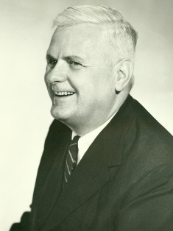
Where is Functional Programming coming from?
Functional programming evolved from lambda "λ" calculus created in the 1930s by Alonzo Church.
It then was developed and used mainly in Academia.
In recent years it became influential, and we may be in the middle of a paradigm shift.
Image source: https://en.wikipedia.org/wiki/File:Alonzo_Church.jpg (Accessed on Jul 12, 2024)

Slide 4
A possible definition is (from Wikipedia):
Functional programming is a programming paradigm(*) where programs are constructed by applying and composing functions. It is a declarative programming paradigm in which function map values to other values, rather than a sequence of imperative statements which update the running state of the program.
In other words, Functional programming is more about evaluation of expressions, rather than execution of commands.
(*) Examples of other paradigms are object oriented programming and procedural programming.
Source: https://en.wikipedia.org/wiki/Functional_programming (Accessed on July 12, 2024)

Slide 5
A simpler definitions is:
Programming with pure functions, avoiding side effects.
Languages like Haskell, Elm, Idris and PureScript let you write only pure functions. These languages are called purely functional programming languages and let you write code that produce no side effects. Side effects are taken care by the runtime.

Slide 6
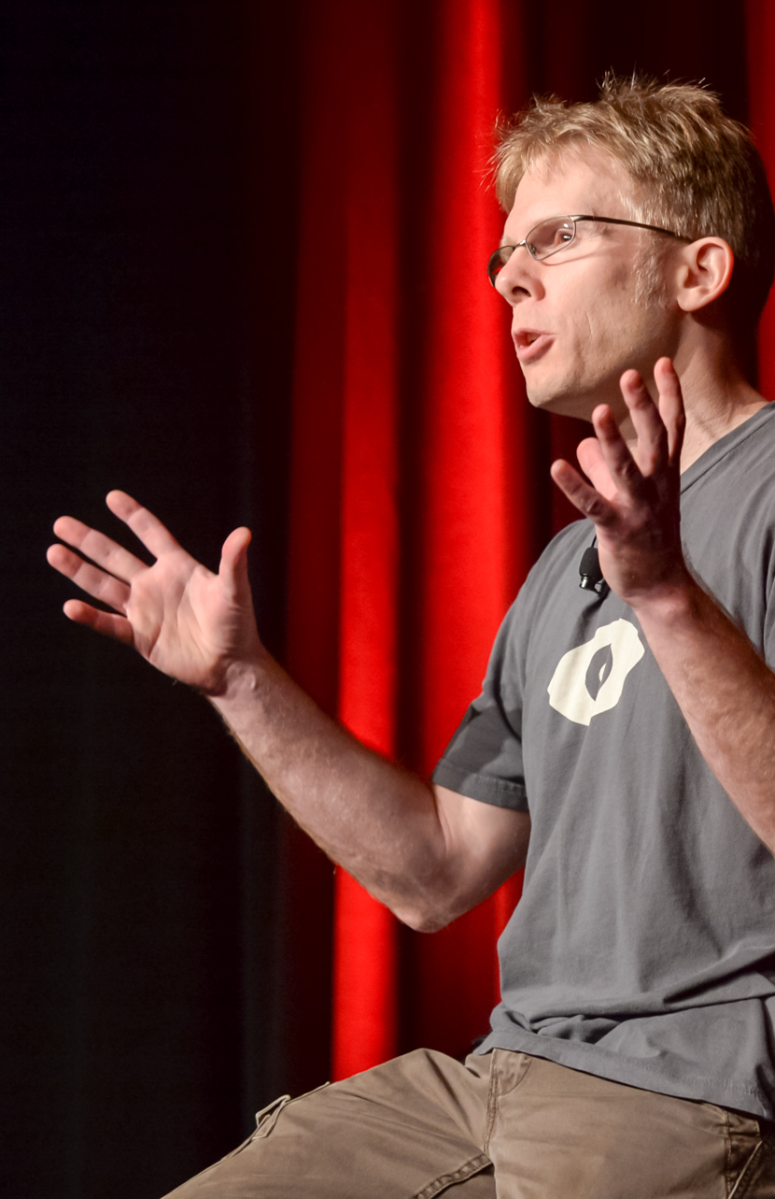
Avoid Side Effects
“A large fraction of the flaws in software development are due to programmers not fully understanding all the possible states their code may execute in”
John Carmack
Quote from https://www.gamedeveloper.com/programming/in-depth-functional-programming-in-c-
Photograph from https://en.wikipedia.org/wiki/John_Carmack (Accessed on Jul 10 2024)
Carmack about Functional Programming https://www.youtube.com/watch?v=1PhArSujR_A&t=127s (Accessed on Jul 10 2024)
Image source: https://commons.wikimedia.org/wiki/File:John_Carmack_-_The_Dawn_of_Mobile_VR_-_Game_Developer_Conference_2015_-_cropped.jpg (Accessed on July 12, 2024)

Slide 7
We defined "Functional Programming".
How can we define a “Functional Programming Language“ now?

Slide 8
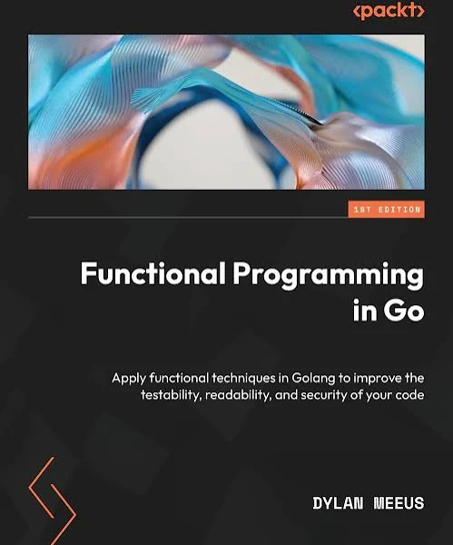
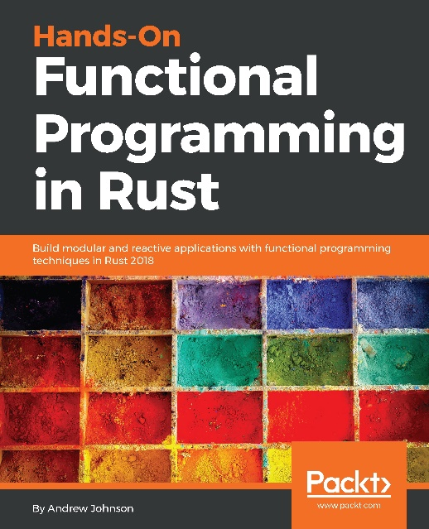
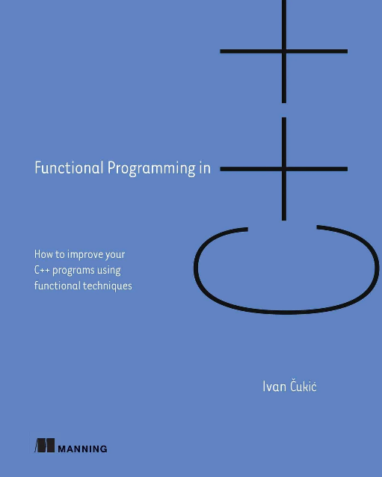
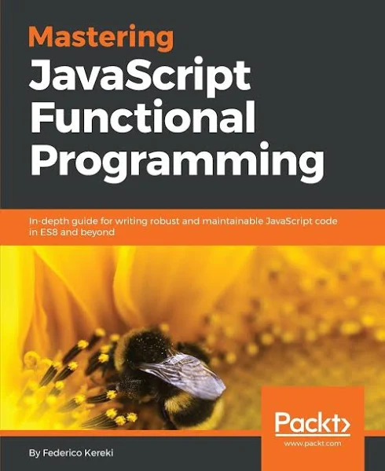
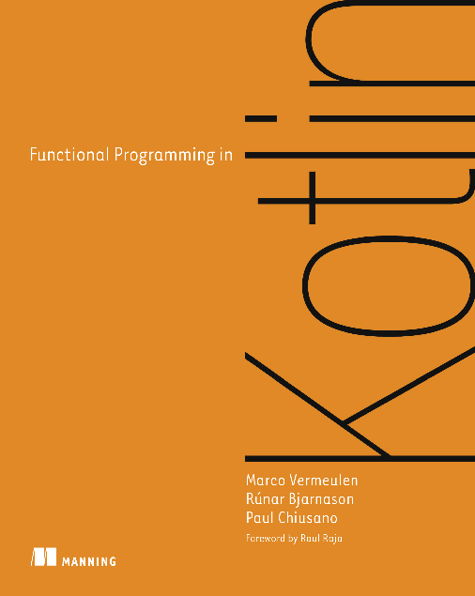
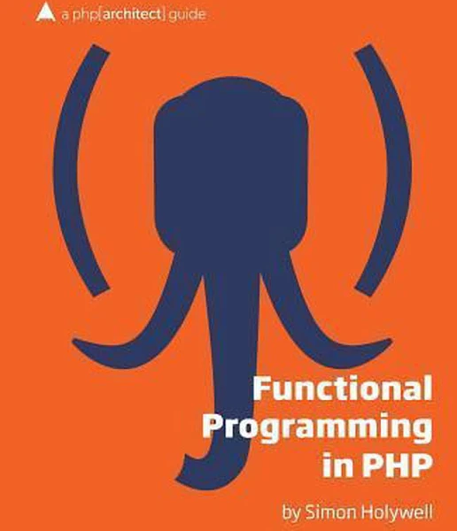
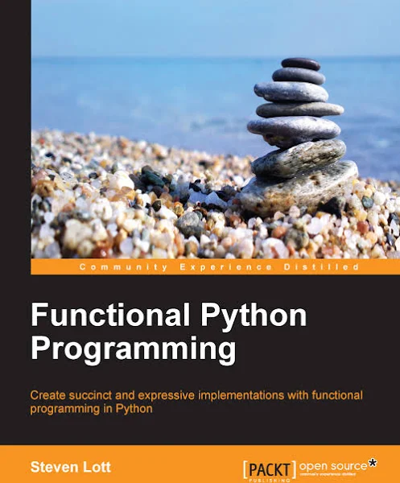
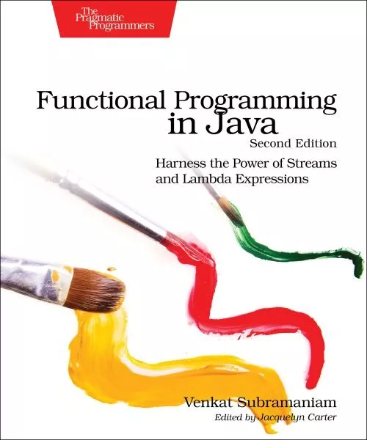

Slide 9
In short
A functional programming language is one that supports and encourages programming without side-effects.

Slide 10

Functional programming languages are distributed in a continuous spectrum. On one side there are languages like assembler or C that have limited support for functional programming. On the other side there are languages like Haskell or Elm that have been designed to write functional code (they enforce and/or encourage writing functional code). Languages like JavaScript and TypeScript are somewhere in between.
Assembler
C
JavaScript
TypeScript
Haskell
Elm

Slide 11
FP style vs Purely Functional
The Functional Programming style describes the use of concepts such as map, reduce, first-class functions, higher-order functions, etc.
Languages that are Purely Functional require the use of pure functions and the persistency of data structure (immutability) .
Throughout this training I tend to refer to the purely version of Functional Programming.

Slide 12
Example of Programming Languages with high level of support for Functional Programming
Pure(*)
Haskell
Elm
Idris
PureScript
Impure
Lisp
Scheme
Clojure
Racket
Erlang
Elixir
Ocaml
F#
Gleam
(*) Purely languages are languages
that only allows pure functions.
In addition, many other programming languages support programming in a functional style or have implemented features from functional programming, such as C++, C# Kotlin, Perl, PHP, Python, Go, Rust, Raku, Scala, JavaScript and Java (since Java 8)

Slide 13
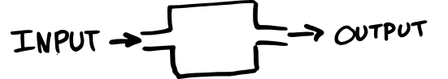
What is a Pure function?
Pure functions are functions that have these two characteristics:
Same input, same output
No side effects

Slide 14
Example of side effects
Mutating something outside the function, for example
DOM manipulation
Global variable manipulations
Logging in the console
HTTP requests

Slide 15
Pure functions – Alternative definition
Another way to define a pure function is:
A function is pure if it can be replaced by a (possibly very large or infinite) lookup table
a | b | sum
1 | 1 | 2
1 | 2 | 3
2 | 1 | 3
2 | 2 | 4
2 | 3 | 5
function sum(a, b) {
return a + b
}

Slide 16
Impure functions
Functions that return the time or a random value are not pure, because cannot be replaced by a lookup table. Every time they are called, they produce a new value.
function ran() {
return Math.random()
}
function now() {
return getTime()
}

Slide 17
Pure functions Predictability
A consequence of pure function is “predictability”. Just looking at the function, is possible to guess the result.
Predictable
Unpredictable
function sum(a, b) {
return a + b
}
sum(3, 7) // returns 10
function rand() {
return Math.random()
}
rand() // returns ???

Slide 18
Mutable Global Variables
Functions that use mutable global variables are unpredictable, unless we are 100% sure about the value of it. So, they are considered Impure because they are not guaranteed to always return the same value.
Predictable
Unpredictable
var globalVariable = 0
function sum(a, b) {
return a + b + globalVariable
}
sum(3, 7) // returns 10
var globalVariable = 0
... other stuff ...
... happening here ...
function sum(a, b) {
return a + b + globalVariable
}
sum(3, 7) // returns ???

Slide 19
Question: Pure or Impure?
Is sumAndDouble Pure or Impure?
☐ 1. Pure
☐ 2. Impure
function sum(a, b) {
return a + b
}
function sumAndDouble(a, b) {
return (sum(a, b) * 2)
}

Slide 20

Question: Pure or Impure?
Is sumAndDouble Pure or Impure?
☐ 1. Pure
☐ 2. Impure
function sum(a, b) {
return a + b
}
function sumAndDouble(a, b) {
return (sum(a, b) * 2)
}
Correct answer: 1. Pure
If a function is pure and call another function that is pure, it maintains its purity, otherwise it gets “contaminated”

Slide 21
Question: Pure or Impure?
Is sum Pure or Impure?
☐ 1. Pure
☐ 2. Impure
var globalVariable = 0
function sum(a, b) {
globalVariable = 1
return a + b
}

Slide 22
Question: Pure or Impure?
Is sum Pure or Impure?
☐ 1. Pure
☐ 2. Impure
var globalVariable = 0
function sum(a, b) {
globalVariable = 1
return a + b
}
Correct answer: 2. Impure
Because it changed a global variable and that is a side effect.

Slide 23
Question: Pure or Impure?
Is getPhoto Pure or Impure?
☐ 1. Pure
☐ 2. Impure
function getPhoto() {
fetch('http://exmaple.com/cat.json')
}

Slide 24
Question: Pure or Impure?
Is getPhoto Pure or Impure?
☐ 1. Pure
☐ 2. Impure
function getPhoto() {
fetch('http://exmaple.com/cat.json')
}
Correct answer: 2. Impure
Because it is using an external system making the outcome both unpredictable (does the http request returns an error? a success? correct data?) and with possible side effect. GET requests do not usually modify a database, but they can still generate log entries, for example.

Slide 25
Question: Pure or Impure?
The increment function is:
☐ 1. Pure
☐ 2. Pure if i is immutable
☐ 3. Pure if i is mutable
☐ 4. Impure
function increment() {
return i + 1
}

Slide 26
Question: Pure or Impure?
The increment function is:
☐ 1. Pure
☐ 2. Pure if i is immutable
☐ 3. Pure if i is mutable
☐ 4. Impure
function increment() {
return i + 1
}
Correct answer: 2. Pure if i is immutable
Because increment does not accept any argument, it must always return the same value. This is possible only if i is immutable.

Slide 27
Pure Functions benefits
Pure functions...
.. are easy to read and reason about
because function’s dependencies are explicit
.. are easy to test
because their sole responsibility is to map input -> output,
without side effects
.. are cacheable
because the same input always yields the same output. We can
memoize expensive operations
.. are movable
.. facilitate dead code elimination
.. are thread-safe
.. have good performance

Slide 28
a = 2
c = a + b
b = 3

Slide 29

Example of moveability
Pure functions are movable, this create an abstraction over the order of evaluations.
Imperative
Functional (*)
a = 2
c = a + b
b = 3
Uncaught Reference Error:
“b” is not defined
a = 2
c = a + b
b = 3
Evaluates successfully to c == 5
(*) You can see a working implementations of this example written in Elm here: https://ellie-app.com/rC9X5vfBVbVa1

Slide 30
Step by step, top-down
a = 2
c = a + b
Error, b is not defined yet!
Substitution
main = c
main = a + b
main = 2 + 3
main = 5
a = 2
c = a + b
b = 3
Uncaught Reference Error:
“b” is not defined
a = 2
c = a + b
b = 3
Evaluates successfully to c == 5

Slide 31
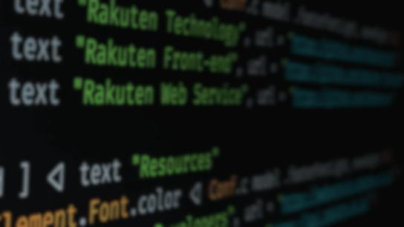


The Developer eXperience
What are the benefits of writing functional code?
“A good measure of a language quality is how much trouble can I get myself in”

Slide 32
Dynamic imperative Language
Following there are some questions that we usually ask ourselves when writing code in a dynamic imperative language.
These are important questions that we need to answer carefully if we want to write good quality code.
It is a lot of stuff to think about and to be worried about...

Slide 33
Dynamic imperative Language
Can I move those pieces of code? Maybe
Should I wrap this in a try-catch because it may crash? Maybe
Can I trust this third-party library? Better to audit the code of it
Should I check if this function or method exists before using it? Probably yes
Can I remove this function? Not sure
Is there any edge case that I forgot to consider? Likely
Is this function pure? Hard to tell. Does it change any global value? Does any side effects? Does it depend on any non-pure function? Do you have meta-programming?
What inputs this function depends on? Better to check all implicit dependencies.
Would updating the dependencies break my code? Likely
Would this run in IE11? Maybe
The state is wrong, which function should I blame? Not sure
Could this value be null or undefined? Yes
Is this value evaluated as true or false? Need to learn about “truthiness”
What is the correct type annotation of this function? Trial and error

Slide 34
Purely Functional Language
When moving to a purely functional language, all these questions are automatically answered by the system.

Slide 35
Purely Functional Language
Can I move those pieces of code? Yes
Should I wrap this in a try-catch because it may crash? No
Can I trust this third-party library? Just look at the type annotations
Should I check if this function or method exists before using it? No
Can I remove this function? Yes if it compiles
Is there any edge case that I forgot to consider? No
Is this function pure? Yes
What inputs this function depends on? Only its arguments
Would updating the dependencies break my code? No
Would this run in IE11? Yes
The state is wrong, which function should I blame? The update function
Could this value be null or undefined? No
Is this value evaluated as true or false? “truthiness” does not exist in Elm
What is the correct type annotation of this function? Type annotations are optional and correctly inferred by the compiler

Slide 36


Stress-free Developer Experience
So, when using a purely functional language these questions all disappear.
This gives us peace of mind and a lot of extra time to care about what we value the most, like: implementing important features, caring about UX, usability, and so on.

Slide 37
Recap
Functional Programming means Programming with pure functions, avoiding side effects.
A Functional Programming Language is a language that supports and encourages functional programming.
Pure Functions are functions that for the same input, return same output, and do not have any side effects. Pure functions have several desirable characteristics

Slide 38
Elm introduction

Slide 39
With all these constrains: Immutability, no side effects, no for-loops (because the counter is a mutable variable)... How can we write something meaningful?
¯\_(ツ)_/¯
Let's try!
Note: These characteristics will be more effective in large code base, but let's see some simple example too, to get an idea.

Slide 40
Goal
Get the feeling of writing purely functional code
Non-goal
Learning the Elm language.
The Elm language is a simple language, but it still requires some time to grasp it, especially if you don't have experience with the ML syntax. Don't worry if you don't get all the details of the coding session, just focus of the larger picture.

Slide 41
What is Elm?
Purely functional Language
Designed to build web applications
Compiles to JavaScript

Slide 42
Elm guarantees
⛔ No runtime exceptions.
🗿 100% immutable data.
💧 100% pure functions.
✅ 100% type inference.
Using the Hindley–Milner type system,
type annotations are optional
Guarantees are maintained also for all dependencies!
Notes:
These are guarantees that at the moment no other mainstream framework can give you.
Again, note that these guarantees also cover 100% of your dependencies.

Slide 43
No need to…
No need to use try…catch blocks
No need to test if a method/function exists
No need to test if a value is defined
No need to test if a value is of the right type
No need to learn “truthiness”
No need to write types*
(*) Even if optional, we add them because they are good as documentation, but they are usually inferred by the code editor

Slide 44

git clone https://github.com/lucamug/FP_HCMUT.git
cd FP_HCMUT
npm install
npm start

Slide 45
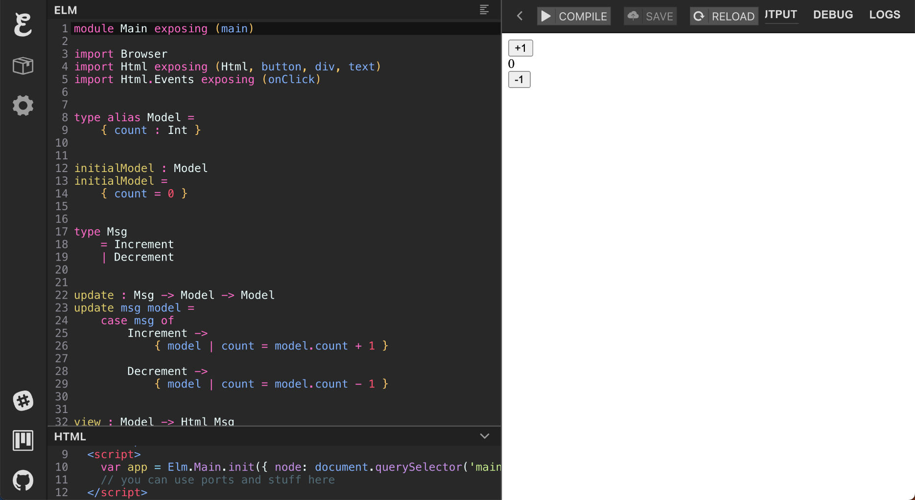
https://ellie-app.com/ (Accessed on Jul 10, 2024)

Slide 46
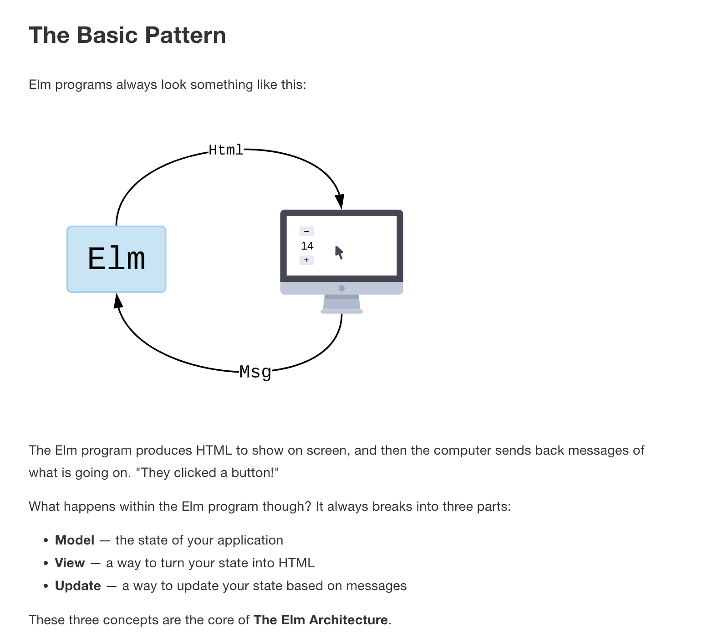
The Elm
Architecture
https://guide.elm-lang.org/architecture/ (Accessed on Jul 10, 2024)

Slide 47
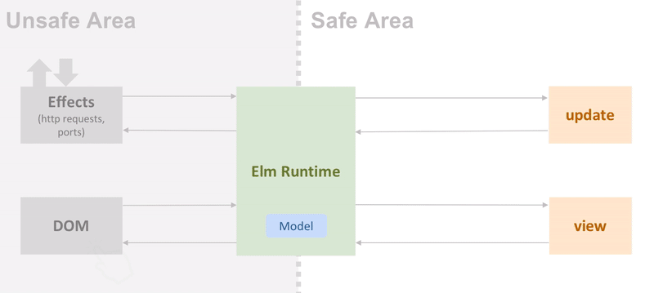
The Elm Architecture loop
Something happen (for example a user click on a button, and http response, etc.)
A message (Msg) is generated
Msg + Model are sent to update
update return a new Model and an optional command (Cmd)
Cmd is sent to the effects engine and executed (example: an http request)
The new Model is sent to the view
view return new html
New html is used to update the web page
Go to step 1 and repeat

Slide 48
Functions definition compared to JavaScript
JavaScript
Elm
function sum (a, b) {
return a + b;
}
sum a b = a + b
const sum = (a, b) => a + b
sum = \a b -> a + b
It is like JavaScript but without decorations (no commas, no parenthesis, no keywords such as “function”, “return” or “const”)

Slide 49
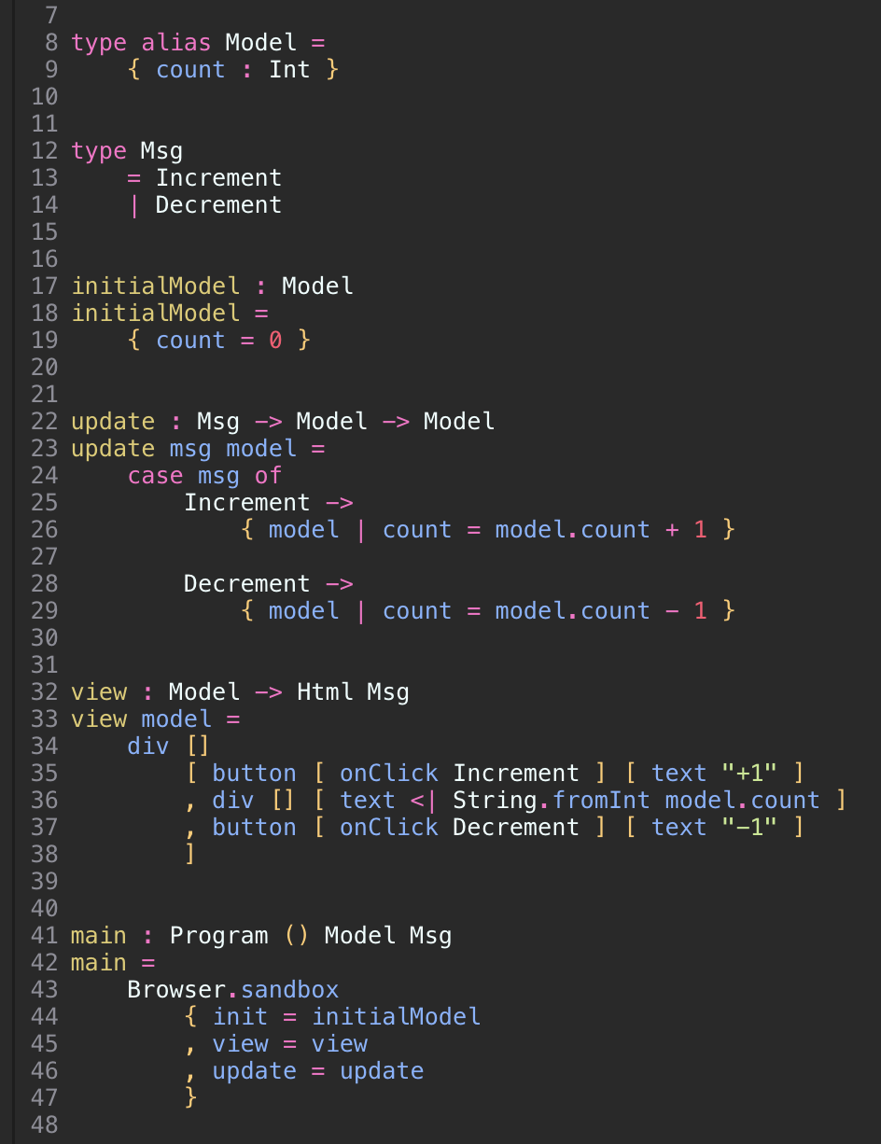
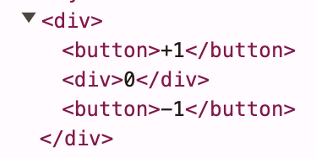
Counter (ML syntax)

Slide 50
Counter (ML syntax)
The last one is the returned type
Input arguments
"Type signature" (or "type annotation" separated by "->")
Function definition
Pattern matching (exhaustive)
Record copy (because immutability)

Slide 51
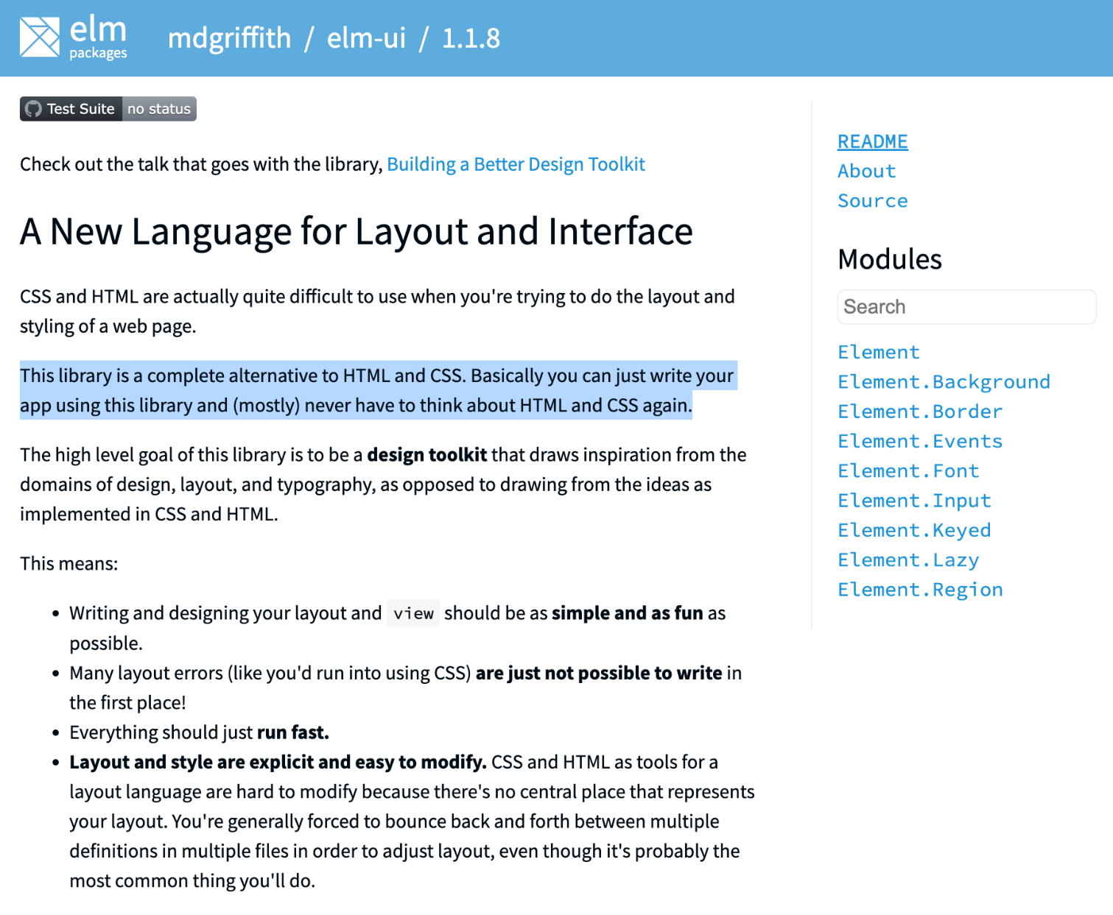
https://package.elm-lang.org/packages/mdgriffith/elm-ui/latest/ (Accessed on Jul 10, 2024)

Slide 52
Let's code!

Slide 53


rakuten.com.tw

Slide 54

The functional paradigm is not complicated (it can be simpler than OOP, everything is a function)
It is regularly used in the industry for practical applications
It can provide a better developer experience
We may be in the middle of a paradigm shift

Slide 55
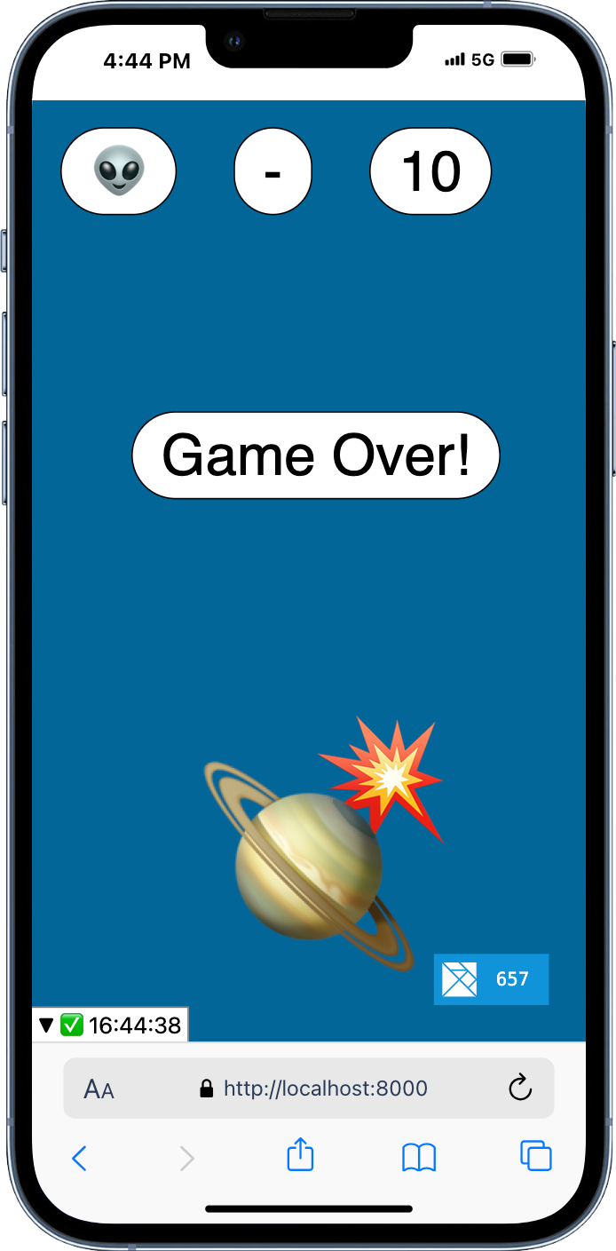

Slide 57
Appendix

Slide 58
Functional Programming Jargon
These are many “fancy” words in the Functional world, like Monads, Functors, Lazy evaluation, polymorphism, etc. We will try to avoid the most esoteric but let’s try to learn some of the simpler.
Also, Map, Filter, Reduce, etc. are NOT functional programming, but just tools that help to write functional code.

Slide 59
Other concepts in functional programming
Immutability
Pattern Matching
First-Class and Higher-Order functions
Recursion
Currying
Hindley–Milner type system
Monads
These are concept usually associated to Functional Programming and found in the main Functional languages. Following we will analyze these concepts but keep in mind that these are not requirement of the Functional Paradigm.

Slide 60
Immutability
Once a value is set, it cannot be changed
Makes it simple to write durable code, you can be sure that your values won’t change out from under you
Makes concurrency very simple
How to change the state? You pass it to a function that return a new state
Purely Functional languages such as Haskell, Elm, Idris and TypeScript support immutability natively.
Adding immutability to languages that do not support it natively can be cumbersome. See, for example, this article about adding immutability to JavaScript: https://dev.to/glebec/four-ways-to-immutability-in-javascript-3b3l

Slide 61
Pattern Matching
Specifying patterns to which some data should conform and then checking to see if it does and deconstructing the data according to those patterns
JavaScript
Elm
reduce = (func, acc, list) => {
if(list.length === 0) {
return acc;
} else {
const [x, ...xs] = list;
return reduce(func, func(x, acc), xs);
}
}
reduce((a, b) => a + b, 0, [1,2,3,4])
// Returns 10
reduce func acc list =
case list of
[] -> acc
x :: xs -> reduce func (func x acc) xs
reduce (\a b -> a + b) 0 [1,2,3,4]
-- Returns 10
An implementation of “reduce” (also called “fold”, “accumulate”, “aggregate”, or “compress” in other languages) without pattern matching on the left and with pattern matching on the right. “func” is also called the “reducer”

Slide 62
First-Class, Higher-Order and Function Composition
foo is the composition of the functions f, g and h. “compose”, “<<“ and “.” are higher-order functions and JavaScript, Elm and Haskell support First-Class functions.
We already talked about pure functions. Let’s now analyze other two concepts related to functions First-Class, Higher-Order and Function Composition:
A language that support First-Class functions is a language that can treat functions as values
Higher-Order functions are functions that receive or return other functions
Function Composition is the mechanism to combine simple functions to build more complicated ones. It is one of the core idea behind Functional Programming
These concepts are closely related to each other and are common in most languages.
JavaScript
compose = (...fns) =>
(initialVal) =>
fns.reduceRight(
(val, fn) => fn(val), initialVal
);
foo = compose(f, g, h)
Elm
Haskell
foo = f << g << h
foo = f . g . h

Slide 63
Recursion and Tail-call Optimization
Looping is not a thing in functional languages, because it requires updating a loop value that would break immutability. Looping is done with recursion: a function calling itself.
Tail-call optimization is a technique to make recursion not to blow up with some stack overflow issue. It converts recursion to iteration.
The outcome of the compilation from Elm to JavaScript is not recursive anymore. It has been automatically tail-call optimized
Recursive Factorial (Elm)
helper n productSoFar =
if n <= 1 then
productSoFar
else
helper (n - 1) (n * productSoFar)
factorial n = helper n 1
factorial 5 -- Returns 120
function helper(n, productSoFar) {
while (true) {
if (n <= 1) {return productSoFar}
productSoFar = n * productSoFar
n = n - 1
}
}
function factorial(n) {return helper(n, 1)}
factorial(5) // Returns 120
Here we move to a lover level of abstraction, a purely functional code get converted into imperative code. A similar conversion happen several time until we reach machine code.

Slide 64
Currying
Translating a function that take multiple arguments into the composition of functions with one argument,
It allows for “partial applications”, where a function is called with a partial quantity argument and returns a new function expecting for the rest of missing arguments. This function can possibly cache heavy elaboration so that they are calculated only once,
Currying in JavaScript
Currying in Elm (*)
sum = a => b => a + b;
sum(3)(4) // Returns 7
sum3 = sum(3) // Partial application
sum3(4) // Returns 7
// more advanced currying can be achieved using
// external libraries such as lodash
sum = (a, b) => a + b;
curriedSum = _.curry(sum);
curriedSum(3, 4); // 7, still callable normally
curriedSum(3)(4); // 7, called partially
sum a b = a + b
sum 3 4 -- Returns 7
sum3 = sum 3 -- Partial application
sum3 4 -- Returns 7
(*) In Elm, as in other functional languages, functions are automatically curried.

Slide 65
Hindley–Milner type system
Several functional languages use this types system, such as Haskell, Ocaml, Elm and F#
Hindley–Milner is a sound and complete type system. This means that it provides these guarantees:
All the code is guaranteed to be properly typed
Type annotations are optional
Note that TypeScript uses a different system that is not not sound

Slide 66
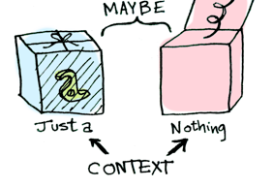
Functors, Applicatives, And Monads
These are concepts that may be difficult to explain but are used regularly when writing code.
The basic intuition is that a Monads combine two computations into one larger computation. They make it possible to compose functions where this seems to be impossible.
For more info about Functors, Applicatives, And Monads:
https://lucamug.medium.com/functors-applicatives-and-monads-in-pictures-784c2b5786f7
https://jxxcarlson.medium.com/monads-in-elm-6135f573e8f

Slide 67
No runtime exceptions
The Hindley–Milner type system in conjunction with other characteristics guarantees no runtime exceptions. This means that all possible errors are intercepted before deploying the code to production. Some of these characteristics are:
Replace throwing exceptions with types. For example “Maybe”, ”Result”, “Either”
Move the concept of null and undefined into the type system
Enforce that all the code is typed. For example, JSON structure need to be parsed and converted

Slide 68
No runtime exceptions – The Maybe type
As example, let’s see how null and undefined can be embedded in the type system using the Maybe type (called also Option type). The Maybe type in several languages such as Haskell, Elm, Idris, Agda, etc. is defined as:
Maybe a = Just a | Nothing
This, in plain English, means that whenever you get a Maybe a, that is like a closed container that either contains some data of type a (Int, String, Boolean, etc.) or contains nothing, it may be empty.
This can be useful when functions may fail. For example, let’s consider a function that convert a string to a number that may fail if a string does not contain a number. The type annotation of such function can be
stringToNumber: String -> Maybe Int
Once you get your result as Maybe Int, you cannot use in math calculation yet, because it is inside the container. So you need to open first. For example, to add this number to 3, we can do
case (stringToNumber string) of
Just number -> Just (number + 3)
Nothing -> Nothing
Note how we need to keep using the Maybe type. The problem of the conversion must propagate down into our code until, somewhere, we will be finally able to deal with it, maybe showing an error to our user “Sorry but the value provided is not containing a number”. This is how some functional language could get rid of null.
https://en.wikipedia.org/wiki/Option_type

Slide 69
Advanced:
Lambda Calculus and Category Theory
There are other theories related to functional programming that are not strictly necessary to learn to write functional code, but they can deepen your understanding of functional programming.

Slide 70
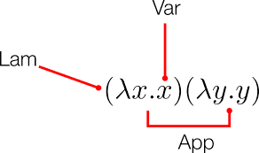
Lambda Calculus
As mentioned earlier, Lamba Calculus, sometimes
described as the world’s smallest programming
language, invented by Alonzo Church is the foundation of functional programming, sometime referred as the "assembly language" of functional programming. It may not have much of a useful practical application, but it may be interesting to learn it to understand where functional programming is coming from.
In several languages, like Pyton, Java or Lisp, “lambda”, that comes from lambda calculus, means a function without a name.
In other functional languages like Haskell and Elm, ironically, these functions are simply called “anonymous functions”, but are written starting with the character “\” that stand for the character lambda “λ”

Slide 71
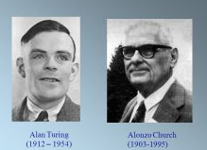
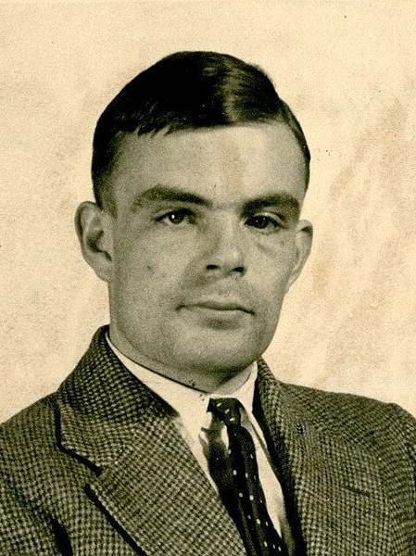
Lambda Calculus
It is an interesting mental exercise to see how a simple system, only based on three rules: Variables, Abstractions (to define functions) and Applications (used to apply functions to data) can express anything that can be computed. In Lambda Calculus there are no predefined numbers, strings, booleans, operators, like + - * /, objects, datatypes, etc. It is a “universal model of computation” that can be used to simulate any Turing machine. Alonzo Church was the PhD supervisor of Alan Turing).
Image source: https://en.wikipedia.org/wiki/File:Alonzo_Church.jpg (Accessed on Jul 12, 2024)
Image source: https://commons.wikimedia.org/wiki/File:Alan_Turing_(1912-1954)_in_1936_at_Princeton_University.jpg (Accessed on July 12, 2024)

Slide 72
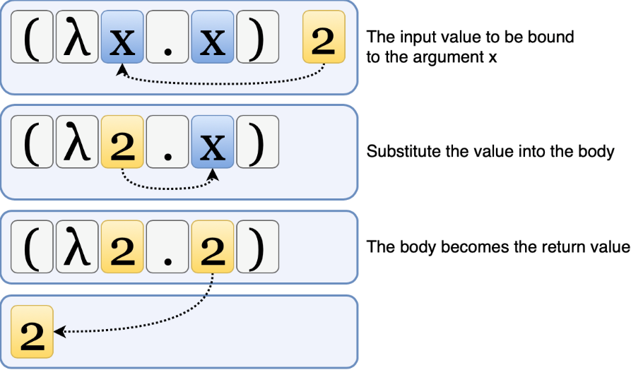
Lambda Calculus – Examples
Examples of lambda calculus expressions and analogue JavaScript:
λx.x is the equivalent of x => x in JavaScript and
So (λx.x) 2 is the same as (x => x)(2) that evaluate to 2.
This is how TRUE and FALSE can be represented in Lambda Calculus (again, in Lambda Calculus there are no primitives, so also TRUE and FALSE need to be defined with functions):
TRUE := λx.λy.x TRUE = x => y => x ,
FALSE := λx.λy.y FALSE = x => y => y ,
Then NOT, for example, can be defined as:
NOT := λp.p FALSE TRUE ,
NOT = p => p(FALSE)(TRUE) ,
This is the outcome if you execute these lines In NodeJS:
It is remarkable to see how we can build the TRUE and FALSE
primitives just using functions.
Welcome to Node.js v16.13.2.
> TRUE = x => y => x
[Function: TRUE]
> FALSE = x => y => y
[Function: FALSE]
> NOT = p => p(FALSE)(TRUE)
[Function: NOT]
> NOT(TRUE)
[Function: FALSE]
> NOT(FALSE)
[Function: TRUE]

Slide 73
Question – Lambda Calculus result
If TRUE and FALSE are defined as
TRUE = (x) => (y) => x;
FALSE = (x) => (y) => y;
and
F = (p) => (q) => p(q)(p);
What is the outcome of the following lines?
F(TRUE)(TRUE);
F(TRUE)(FALSE);
F(FALSE)(TRUE);
F(FALSE)(FALSE);
The outcome is:
☐
☐
[Function: TRUE]
[Function: FALSE]
[Function: FALSE]
[Function: FALSE]
[Function: TRUE]
[Function: TRUE]
[Function: TRUE]
[Function: FALSE]

Slide 74
Question – Lambda Calculus result
If TRUE and FALSE are defined as
TRUE = (x) => (y) => x;
FALSE = (x) => (y) => y;
and
F = (p) => (q) => p(q)(p);
What is the outcome of the following lines?
F(TRUE)(TRUE);
F(TRUE)(FALSE);
F(FALSE)(TRUE);
F(FALSE)(FALSE);
The outcome is:
☐
☐
[Function: TRUE]
[Function: FALSE]
[Function: FALSE]
[Function: FALSE]
[Function: TRUE]
[Function: TRUE]
[Function: TRUE]
[Function: FALSE]
The correct answer is the one above. The function F behave like the logic operator AND. The second outcome is the result of the logic operator OR that can be defined as
OR = (p) => (q) => p(p)(q);
You can find more datatypes definitions at https://en.wikipedia.org/wiki/Lambda_calculus#Encoding_datatypes

Slide 75
Lambda Calculus
This is not a practical way of writing code. Also purely functional language like Haskell and Elm do not define primitive this way, as it would not have good performance. But it is an interesting intellectual idea to see how everything can be built from three simple concepts.
For a gentle introduction to Lambda Calculus, we recommend these videos:
https://www.youtube.com/watch?v=eis11j_iGMs
https://www.youtube.com/watch?v=3VQ382QG-y4
https://www.youtube.com/watch?v=pkCLMl0e_0k

Slide 76
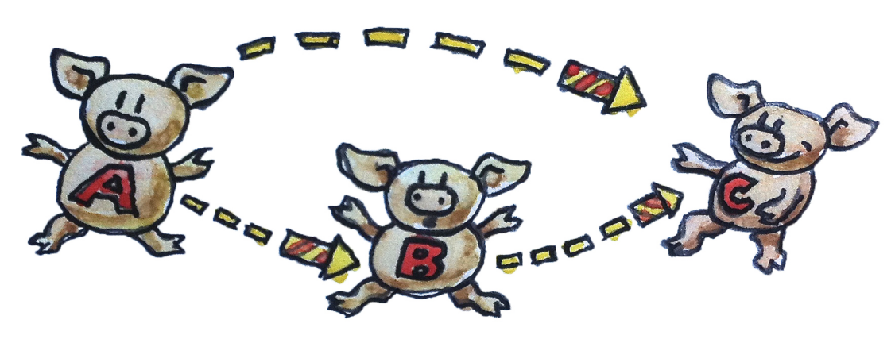
Category Theory
For an introduction to Category
Theory, we recommend the book
“Category Theory for Programmers”
available for free at
https://github.com/hmemcpy/milewski-ctfp-pdf
From the book:
Category theory is a treasure trove of extremely useful programming ideas. Haskell programmers have been tapping this resource for a long time, and the ideas are slowly percolating into other languages.
Category theory is the kind of math that is particularly well suited for the minds of programmers. That’s because category theory — rather than dealing with particulars — deals with structure. It deals with the kind of structure that makes programs composable. And composition is the essence of programming.
There’s been a steady stream of new functional features invading imperative languages. Even Java, the bastion of object-oriented programming, let the lambdas in.

Slide 77
Other concepts of interest
“The Algebra of Algebraic Data Types”
https://www.youtube.com/watch?v=YScIPA8RbVE
“Simple Algebraic Data Types”
https://bartoszmilewski.com/2015/01/13/simple-algebraic-data-types/
“Types as Sets”
https://guide.elm-lang.org/appendix/types_as_sets.html

Slide 78
Selected Sources
https://en.wikipedia.org/wiki/Functional_programming
https://www.youtube.com/watch?v=4_wJ3Z7G6Q4
https://www.fpcomplete.com/blog/2017/04/pure-functional-programming/
http://blog.jenkster.com/2015/12/what-is-functional-programming.html
https://medium.com/javascript-scene/master-the-javascript-interview-what-is-functional-programming-7f218c68b3a0
https://guide.elm-lang.org/
https://www.youtube.com/watch?v=z0N1aZ6SnBk
https://www.youtube.com/watch?v=3n17wHe5wEw
https://www.youtube.com/watch?v=iSmkqocn0oQ
https://www.youtube.com/watch?v=LnX3B9oaKzw
https://www.youtube.com/watch?v=UIUlFQH4Cvo
https://www.youtube.com/watch?v=6YbK8o9rZfI
https://en.wikipedia.org/wiki/Hindley%E2%80%93Milner_type_system
https://www.youtube.com/watch?v=1PhArSujR_A&t=127s (Carmack about Functional Programming)
https://enlear.academy/pure-vs-impure-function-395df7ce6acc
https://functional-programming-in-elm.netlify.app/recursion/tail-call-elimination.html
https://mostly-adequate.gitbook.io/mostly-adequate-guide/
https://www.reaktor.com/blog/fear-trust-and-javascript/
https://www.youtube.com/watch?v=DfLvDFxcAIA
https://www.youtube.com/watch?v=Agu6jipKfYw
https://javascript.info/currying-partials
https://www.youtube.com/watch?v=TYupO6L26YA&t=4978s
https://lucamug.medium.com/functors-applicatives-and-monads-in-pictures-784c2b5786f7
https://jxxcarlson.medium.com/monads-in-elm-6135f573e8f

